Slide 1
CHAPTER 6- AGGREGATE PLANNING
Principles of Supply Chain Management:
A Balanced Approach

Slide 2
Learning Objectives
You should be able to:
  Describe the hierarchical operations planning process in terms of materials planning & capacity planning
  Describe MRP, closed-loop MRP, MRP-II & ERP
  Know how to compute available-to-promise quantities.
  Know how to perform an MRP explosion.
  Distinguish dependent from independent demand inventories.
  Describe the four basic types of inventories & their functions.
  Understand the EOQ model

Slide 3
Chapter Six Outline
Operations Planning
The Aggregate Production Plan: Chase, Level, & Mixed Strategies
Mater Production Scheduling
  Master Production Schedule Time Fence
  Available-to-Promise Quantities
Dependent Demand & Independent Demand
The Bill of Materials
Materials Requirement Planning
Capacity Planning
Independent Demand Inventory Systems
  The ABC Inventory Control System
  The Economic Order Quantity Model

Slide 4

Introduction
Scheduling & inventory management influence how assets are deployed.
Problem: A missed due date or stock-out may cascade downstream, affecting the supply chain.
Operations managers are continuously involved in balance capacity & output.
Here we will discuss:
  Hierarchical operations planning process
  Dependent & independent demand
  Basic types of inventories
  Various inventory management approaches

Slide 5
Matching Supply and Demand
Suppliers must accurately forecast demand so they can produce & deliver the right quantities at the right time at the right cost.
Suppliers must find ways to better match supply and demand to achieve optimal levels of cost, quality, and customer service to enable them to compete with other supply chains.
Problems that affect product & delivery will have ramifications throughout the chain.

Slide 6
Operations Planning
Operations planning is usually hierarchical & can be divided into three broad categories:
Long-range- Aggregate Production Plan (APP) involves the construction of facilities & major equipment purchase
Intermediate- Shows the quantity & timing of end items (i.e., master production schedule- MPS)
Short-range- detailed planning process for components & parts to support the master production schedule (i.e., materials requirement planning- MRP)

Slide 7
Operations Planning- Cont.
Closed-loop MRP- incorporates the aggregate production plan, the master production schedule material requirements plan, capacity requirements plan.
Manufacturing resource planning (MRP-II) incorporates the business & sales plans with the closed-loop MRP system.
Distribution requirement planning (DRP) describes the time-phased net requirements from warehouses & distribution centers customer demand minus any on hand in-transit inventories.

Slide 8

Aggregate Production Plan
Hierarchical planning- process that translates annual business & marketing plans & demand forecasts into a production plan for all products in a plant or facility. Hence, Aggregate Production Plan
Planning horizon of APP- at least one year & is usually rolled forward by three months every quarter
Costs relevant to the aggregate planning decision include inventory, setup, machine operation, hiring, firing, training, & overtime costs

Slide 9
Aggregate Production Plan- Cont.
Three basic production strategies :
Chase Strategy- Adjusts capacity to match the demand pattern. Firm hires & lays off workers to match production to demand. Workforce fluctuates but finished goods inventory remains constant. Works well for make-to-order firms.
Level Strategy- Relies on a constant output rate & capacity while varying inventory & backlog levels according to fluctuating demand pattern. Workforce levels stay constant & firm relies on fluctuating finished goods inventories & backlogs to meet demand. Works well for make-to-stock manufacturing firms.
Mixed Production Strategy- To maintain stable workforce core while using other short-term means, such as overtime, & additional subcontracting or part time helpers to manage short-term demand.

Slide 10
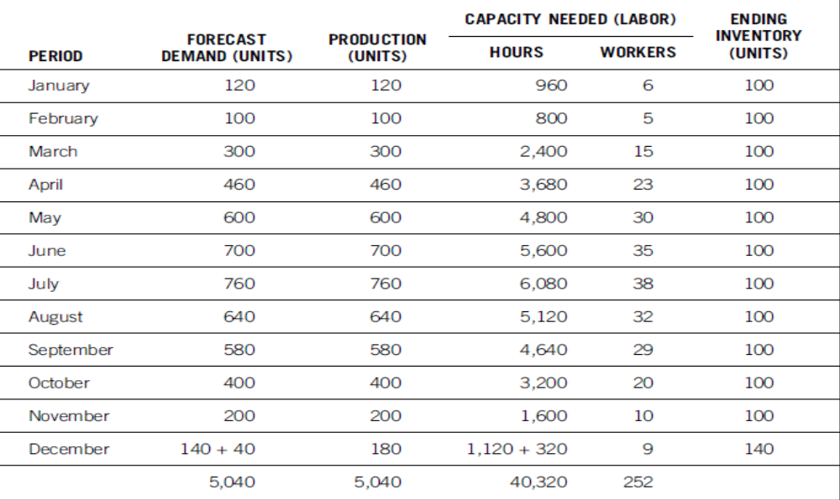
Example-Chase Strategy

Slide 11
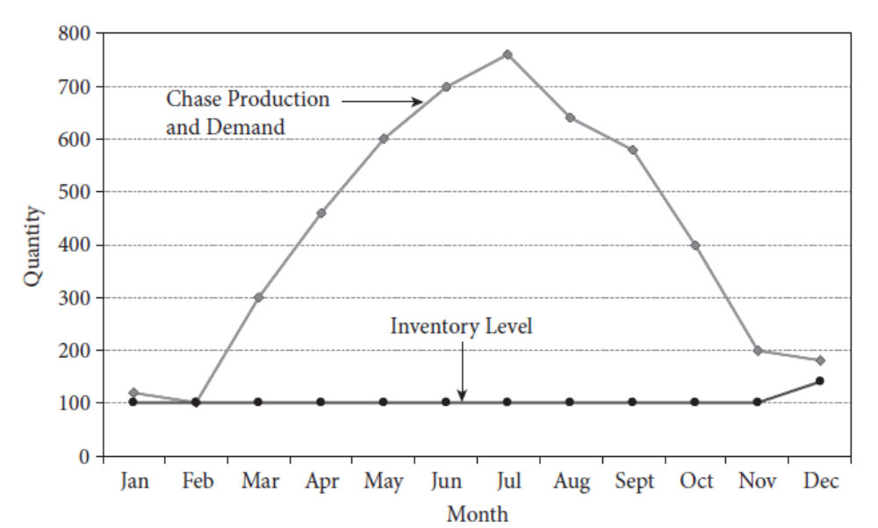
Example-Chase Strategy

Slide 12
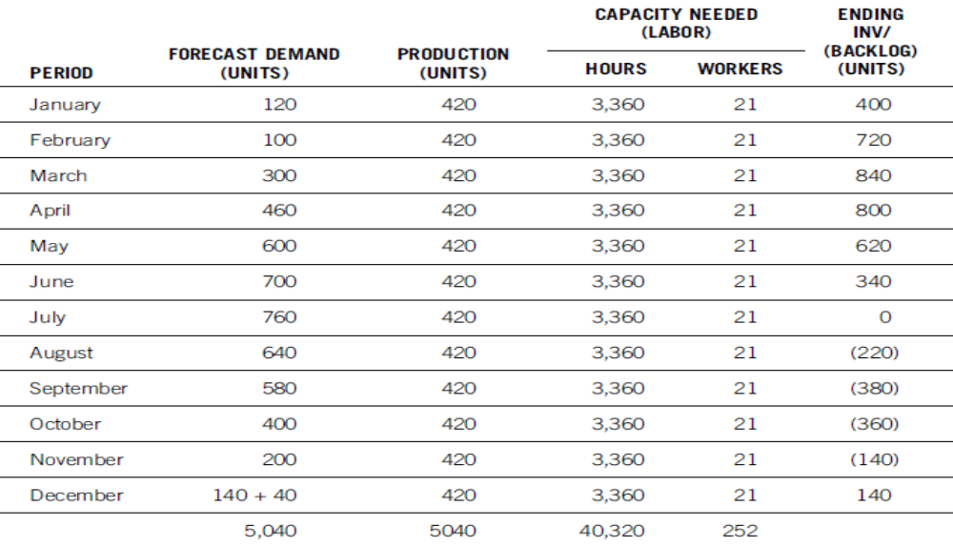
Example-Level Strategy

Slide 13
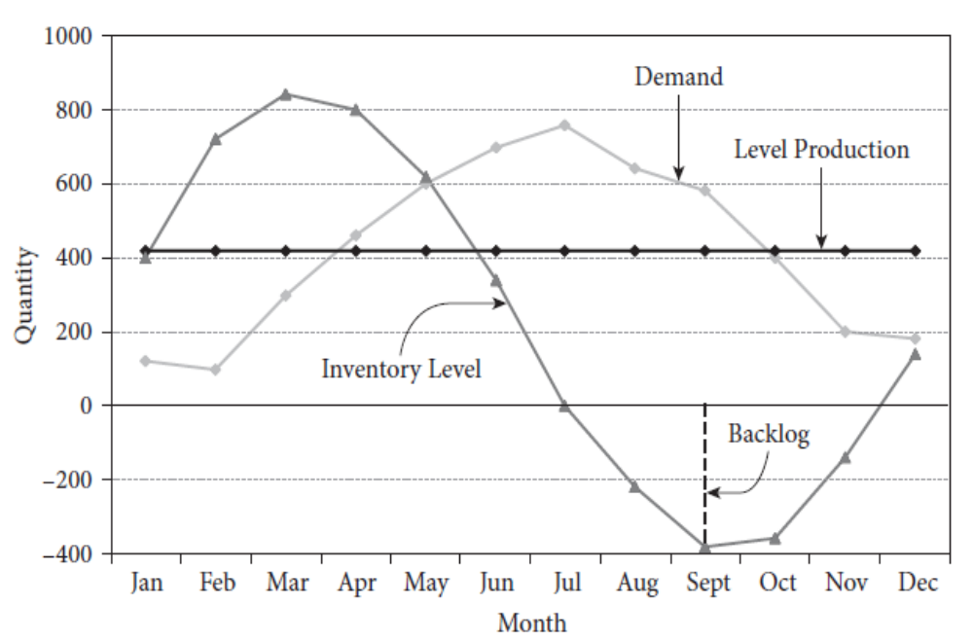
Example-Level Strategy

Slide 14
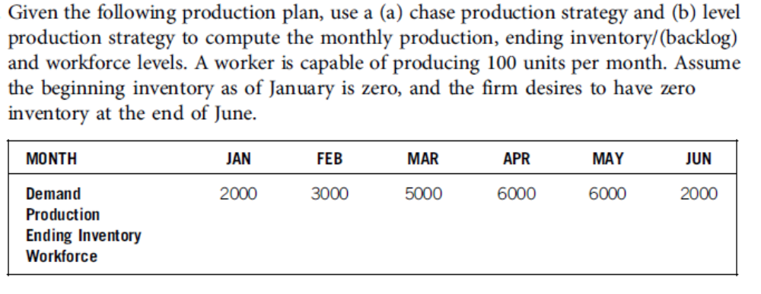
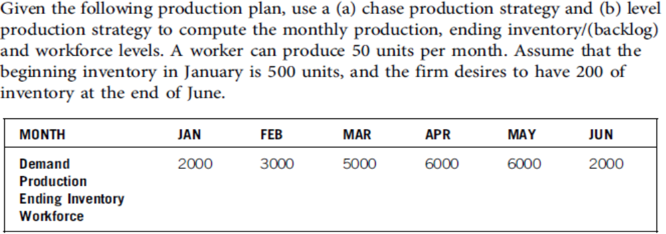
Practice Questions

Slide 15
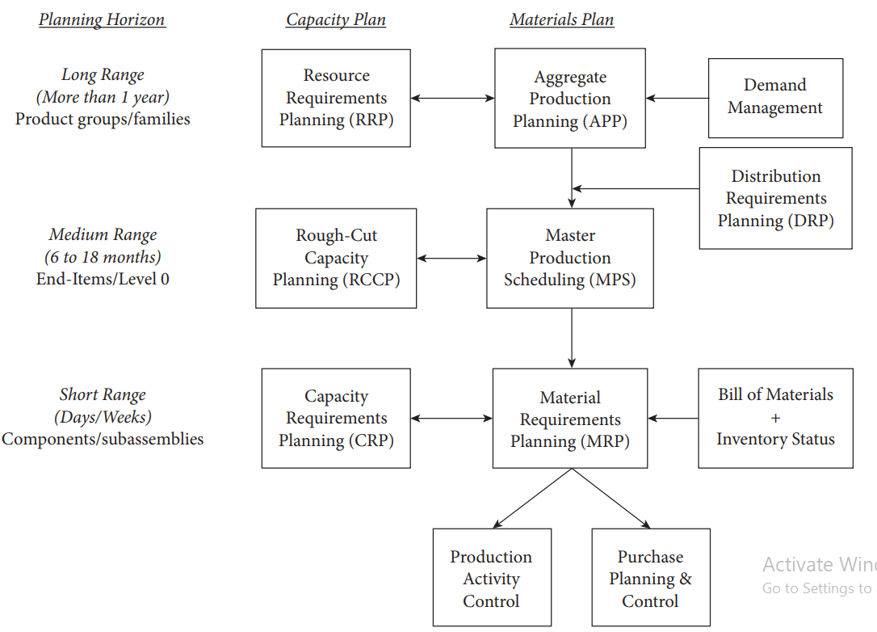
Resource Planning

Slide 16

Master Production Scheduling
Master Production Schedule- A detailed disaggregation of the aggregate production plan, listing the exact end items to be produced by a specific period.
More detailed than APP & easier to plan under stable demand.
Planning horizon is shorter than APP, but longer than the lead time to produce the item.
Note: For the service industry, the master production schedule may just be the appointment log or book, which ensures that capacity (e.g., skilled labor or professional service) is balance with demand.

Slide 17
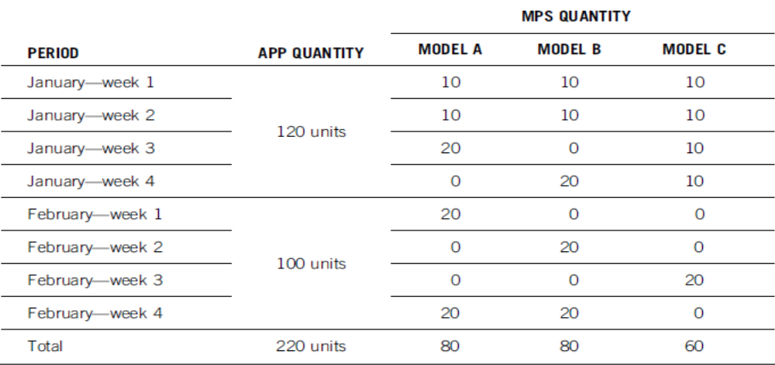
Example of MPS

Slide 18
Master Production Scheduling-Cont.
The MPS is the production quantity to meet demand from all sources & is used for computing the requirements of all time-phased end items.
Frequent changes to the MPS may create system nervousness- Situation where a small change in the upper-level-production plan causes a major change in the lower-level production plan.
Many firms use a time fence system to deal with system nervousness. A time fence separates the planning horizon into two segments
  Firmed Segment (AKA as a demand time fence), from current period to several weeks into future. Can only be altered by senior management.
  Tentative segment (AKA planning time fence), from end of the firmed segment to several weeks farther into the future.

Slide 19
Master Production Scheduling-Cont.
Available-to-Promise (ATP) Quantities-
The MPS decides whether additional orders can be accepted for difference between confirmed customer orders & the quantity the firm planned to produce.
Three basic methods of calculating the available-to-promise quantities:
  Discrete available-to-promise
  Cumulative available-to-promise without look ahead, &
  Cumulative available-to-promise with look ahead.

Slide 20
Master Production Scheduling-Cont.
Discrete Available-to-Promise
Add the Beginning Inventory to the MPS for Period 1, subtracting the Committed Customer Orders.
For the next period, subtract the Committed Customer Orders. If quantity is positive, this becomes the Period 2 ATP. If negative, subtract enough from the previous period’s ATP to make the current period’s ATP zero.
For subsequent periods, follow Step 2.

Slide 21
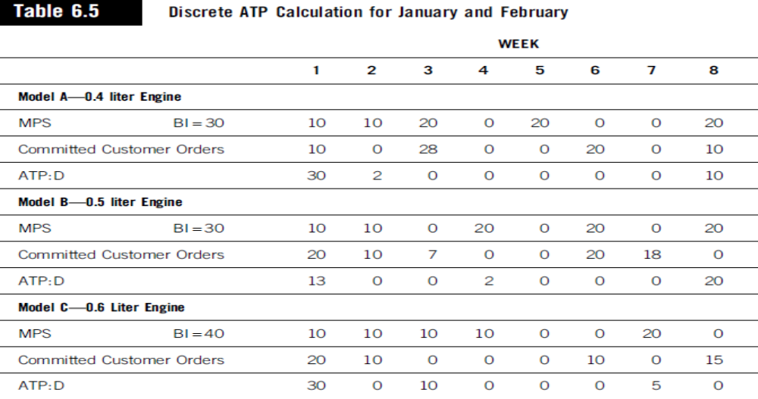
Master Production Scheduling-Cont.

Slide 22
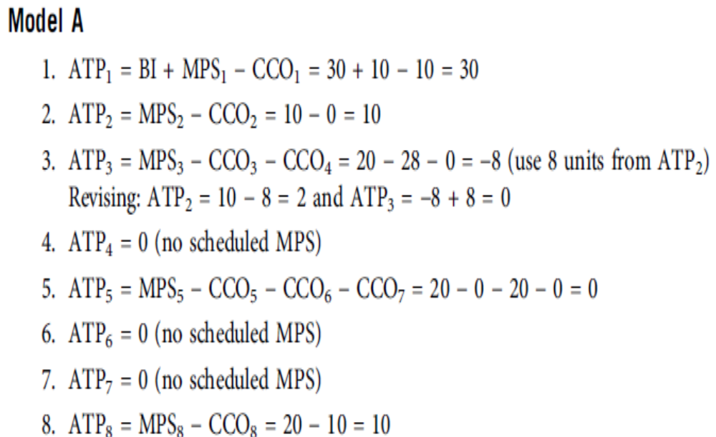
ATP Calculations for Model A

Slide 23
Try To Calculate ATP for Model B & C

Slide 24
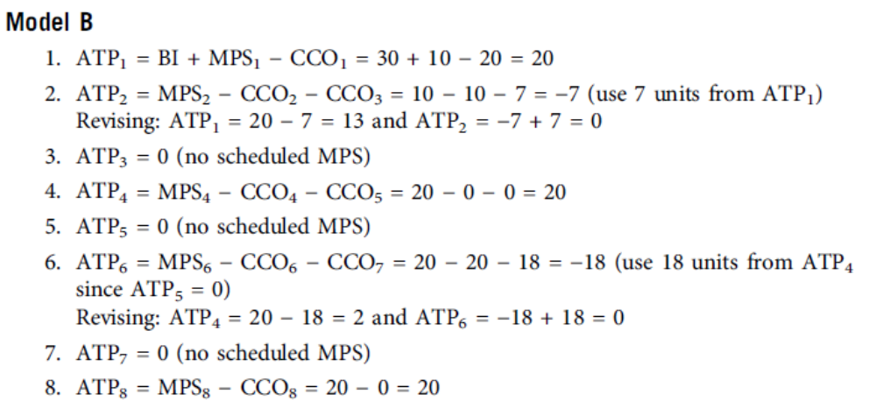
ATP Calculations for Model B

Slide 25
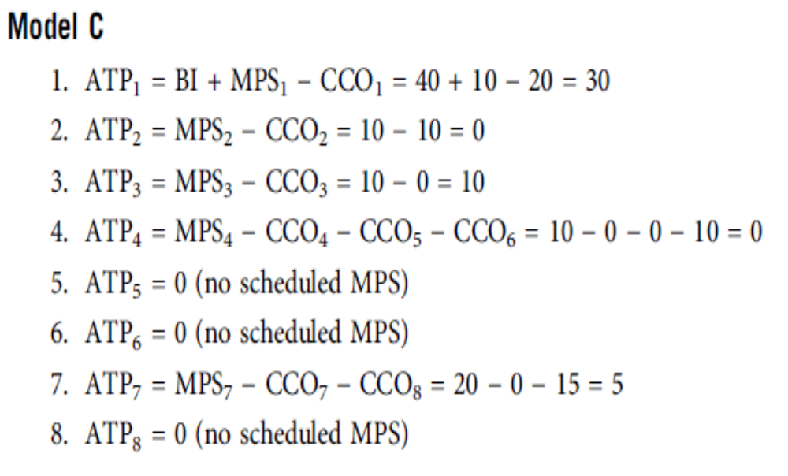
ATP Calculations for Model C

Slide 26
Dependent & Independent Demand
Dependent Demand
Describes the internal demand for parts based on the demand of the final product in which the parts are used. Subassemblies, components, & raw materials are examples of dependent demand items.
Independent Demand
The demand for final products & has a demand pattern affected by trends, seasonal patterns, & general market conditions.

Slide 27
The Bill of Materials
Bill of Materials (BOM)
An engineering document that shows an inclusive listing of all component parts & assemblies making up the final product.
Multilevel Bill of Materials
shows the parent-component relationships & the specific units of components known as the planning factor. The multilevel bill of materials can be presented as an indented bill of materials. At each level of indentation, the level number increases by one.
Super Bill of Materials (AKA planning BOM, pseudo BOM, phantom BOM, or family BOM) enables the firm to forecast the total demand end products.

Slide 28
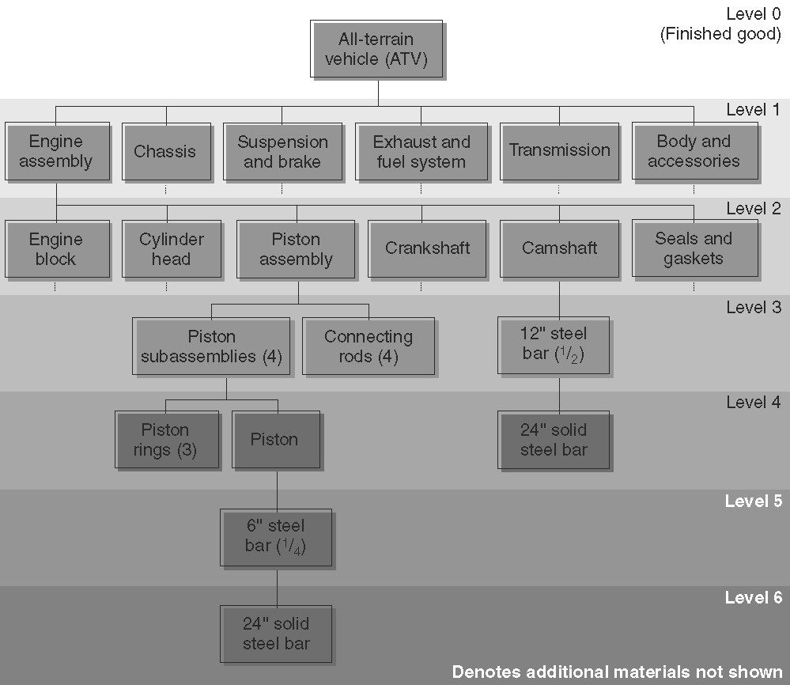
The Bill of Materials- Cont.

Slide 29
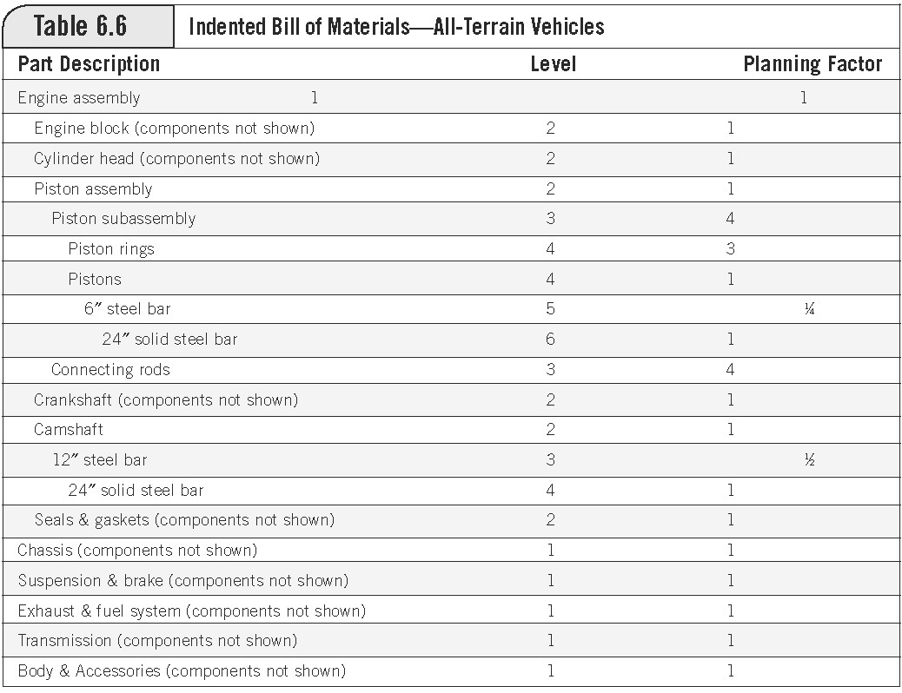
The Bill of Materials- Cont.

Slide 30
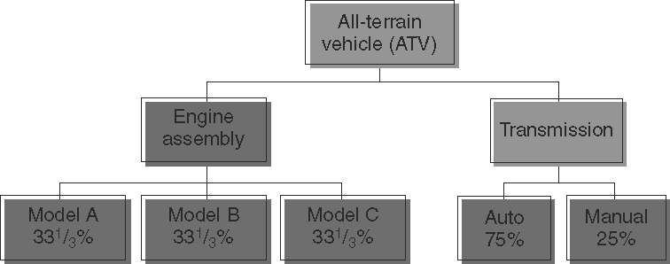
The Bill of Materials- Cont.

Slide 31
Materials Requirement Planning
MRP- A computer-based materials management system. The materials requirement plan calculates the exact quantities, need dates, & planned order releases for subassemblies & materials required to manufacture the final products listed on .
MRP requires:
  The independent demand information.
  Parent-component relationships from the bill of materials.
  Inventory status of the final product & all of the components.
  Planned order releases (output of the MRP system)
Advantage of MRP- provides planning information
Disadvantage of MRP- loss of visibility, especially acute for products with a deep bill of materials, & ignore capacity & shop floor conditions.

Slide 32
Materials Requirement Planning- Cont.
Terms used in Materials Requirement Planning
Parent: Item generating the demand for lower-level components.
Components: parts demanded by a parent.
Gross requirement: A time-phased requirement prior to netting out on-hand inventory & the lead-time consideration.
Net requirement: The unsatisfied item requirement for a specific time period. Gross requirement for that period minus the current on-hand inventory.
Scheduled receipt: A committed order awaiting delivery for a specific period.
Projected on-hand inventory: Projected closing inventory at the end of the period. Beginning inventory minus the gross requirement, plus the scheduled receipt & planned receipt & planned receipt from planned order releases.
Planned order release: Specific order to be released to the shop or to the supplier.

Slide 33
Materials Requirement Planning- Cont.
Terms used in Materials Requirement Planning- Cont.
Time bucket: Time period used on the MRP. Days or weeks.
Explosion: The process of converting a parent item’s planned order releases into component gross requirements.
Planning factor: Number of components needed to produce a unit of the parent item.
Firmed planned order: Planned order that the MRP computer logic system does not automatically change when conditions change to prevent system nervousness.
Pegging: Relates gross requirements for a part to the planned order releases the reverse of the explosion process.
Low-level coding: assigns the lowest level on the bill of materials to all common components to avoid duplicate MRP computations.
Lot size: The order size for MRP logic
Safety Stock: Protects against uncertainties in demand supply, quality, & lead time.

Slide 34
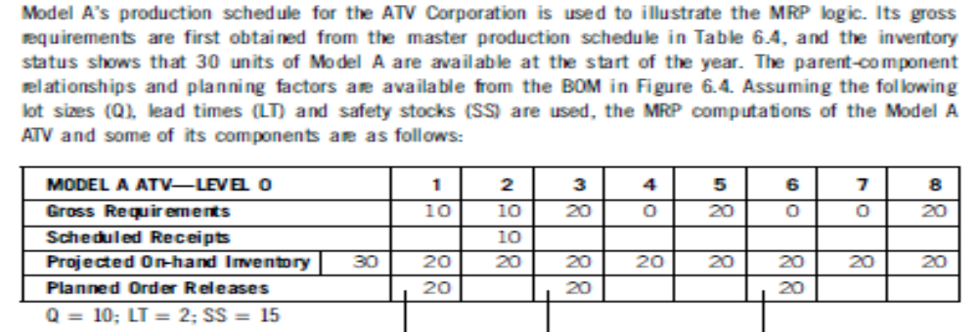
Example

Slide 35
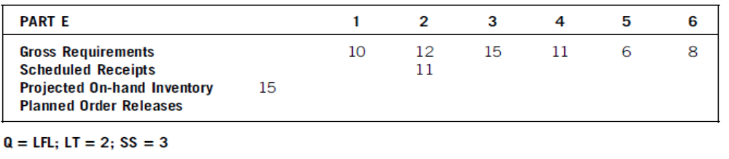
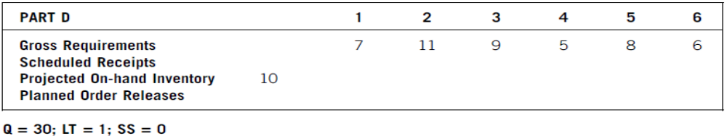
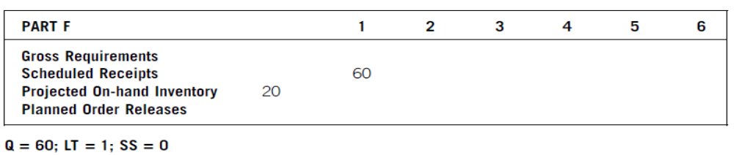
Practice Questions

Slide 36
Capacity Planning
Excess (or insufficient) capacity prevents firm from taking advantage of the efficiency of manufacturing planning & control system.
Resource Requirement Planning (RRP), a long-range capacity planning module, checks whether aggregate resources are capable of satisfying the aggregate production. Resources considered include gross labor hours & machine hours.
Medium-range capacity plan, or rough-cut capacity plan (RCCP), used to check feasibility of MPS. Converts MPS from production needed to capacity required, then compares it to capacity available.
Capacity requirement planning (CRP) is a short-range capacity planning technique that is used to check the feasibility of the material requirements plan.

Slide 37
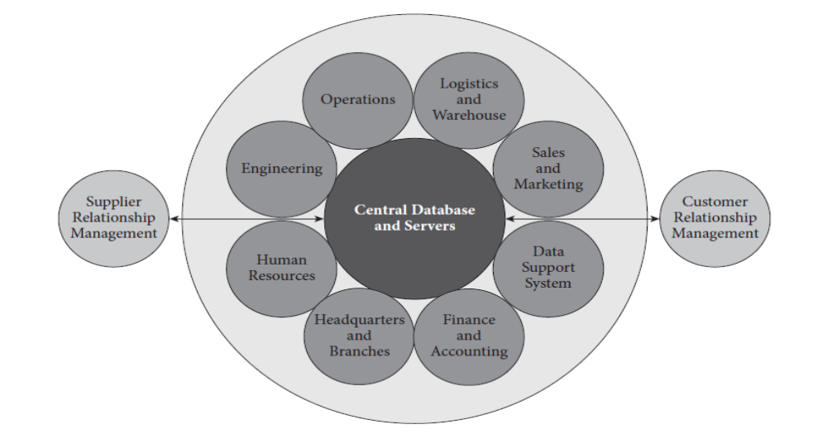
Generic ERP

Slide 38
Independent Demand Inventory Systems
Independent demand inventory system-
Ensures smooth operations & allows storing-up WIP & finished goods.
Service firms are unable to inventory their output, but may use appointment backlogs, labor scheduling & cross-training to balance supply & demand.
Four broad categories of inventories
  Raw materials- unprocessed purchase inputs.
  Work-in-process (WIP)- partially processed materials not yet ready for sales.
  Finished goods- products ready for shipment.
  Maintenance, repair & operating (MRO)- materials used when producing (e.g., cleaners & brooms).

Slide 39

Independent Demand Inventory Systems- Cont.
ABC Inventory Control System- Determines which inventories should be counted and managed more closely than others.
Groups inventory as A, B, and C Items.
A items are given the highest priority with larger safety stocks. A items, which account for approximately 20 % of the total items, account for about 80 % of the total inventory cost
B and C account for the other 80% of total items and only 20% of costs. The B items require closer management since they are relatively more expensive (per unit), require more effort to purchase/make, and may be more prone to obsolescence than the “trivial many” C items.
C items have the lowest priority.

Slide 40
Independent Demand Inventory Systems- Cont.
The Economic Order Quantity (EOQ) Model-
A quantitative decision model based on the trade-off between annual inventory holding costs and annual order costs.
The EOQ model seeks to determine an optimal order quantity, where the sum of the annual order cost and the annual inventory holding cost is minimized.
  Order Cost is the direct variable cost associated with placing an order.
  Holding Cost or carrying cost is the cost incurred for holding inventory in storage.

Slide 41
Independent Demand Inventory Systems- Cont.
Assumptions of the Economic Order Quantity Model
  Demand must be known & constant.
  Delivery time is known & constant.
  Replenishment is instantaneous.
  Price is constant.
  Holding cost is known & constant.
  Ordering cost is known & constant.
  Stock-outs are not allowed.

Slide 42
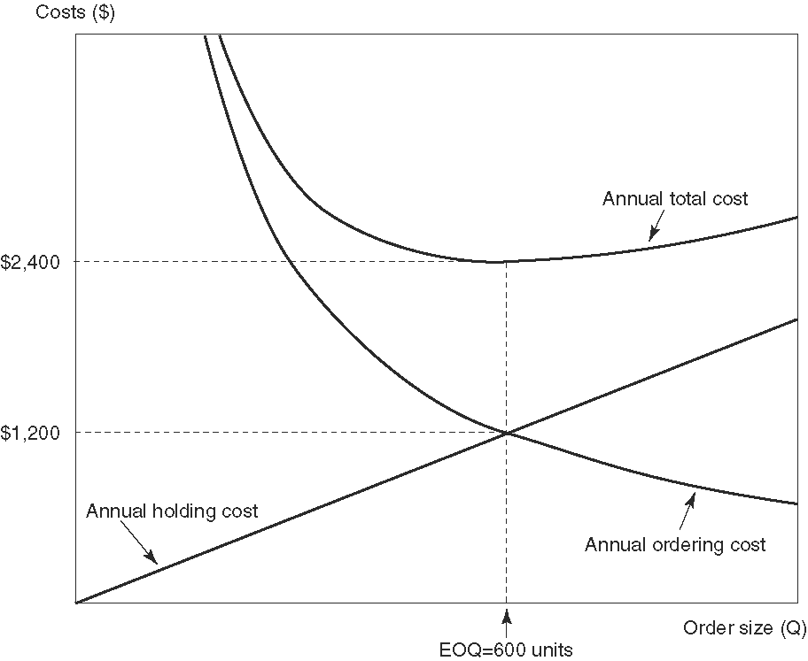
Independent Demand Inventory Systems- Cont.

Slide 43
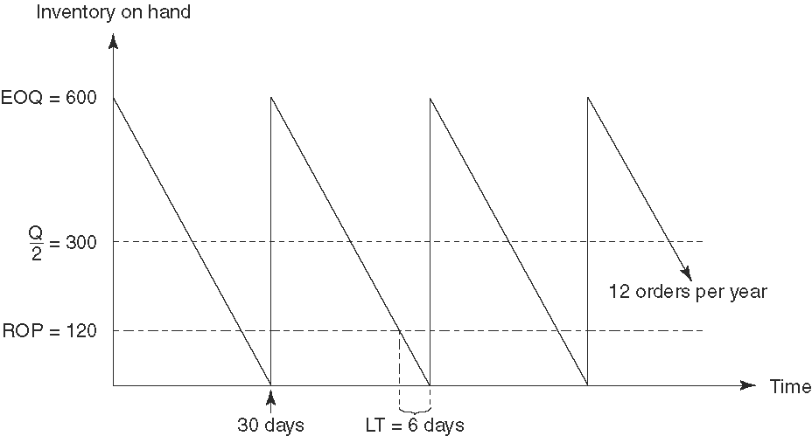
Independent Demand Inventory Systems- Cont.

